Slide 1
Diversity & Voice
Elizabeth Asefa, She/Her/Hers HUIT Equity Diversity Inclusion and Belonging Program Manager
Notes:
To set a different background color: select Format in menu > select Slide Background > choose Fill type and color

Slide 2
Overview
Individual Reflection
Context Setting & Naming Fears
Belonging & Community

Slide 3
Intended Safe Space
Ouch if someone says something that hurts — provide the space to own your feelings.
Oops and genuinely apologize for the ways your intention did not match your impact.
Follow up your apology with some research.
The person affected might not feel like explaining why in that moment, but that doesn’t mean you shouldn’t find a better way to phrase things.
James Madison University LGBTQ & Ally Programs

Slide 4
Personal Reflection
Tragic Death of Freddie Gray in 2015
Silence
Lack of Representation
Fear
Desire to Grow
Sadness
Photo taken at a desk of a television screen showing a still image from CNN broadcast
Notes:
reckless endangerment, involuntary manslaughter, and second degree depraved heart murder. Ultimately, four out of the six officers took their cases to trial, and in each instance, the prosecution was unable to secure a conviction.

Slide 5
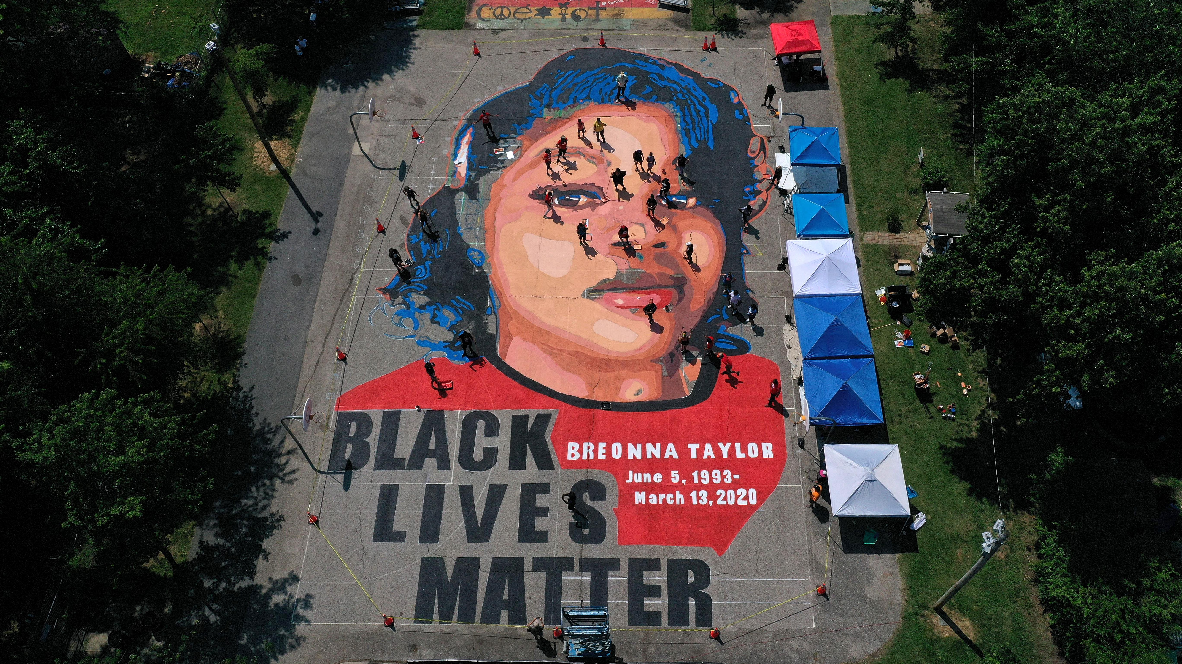
In an aerial view from a drone, a large-scale ground mural depicting Breonna Taylor with the text Black Lives Matter June 5 1993 – March 13, 2020
2020
Notes:
Social Reckoning
Traumatizing
Emotional Shock
Physiological and physical fear

Slide 6
Historical Trauma
Distrust of systems and institutions’
For some the focus on these issues in the workplace was welcome, for others received with skepticism
Long-term commitment
How will my speaking up affect me beyond this moment?
#Metoo movement
Emotional, financial, professional stock of speak up
Events of 2020

Slide 7
Expressing at Work
Fears/ potential backlash
Work
Detract from the value of work
Fear backlash or potential isolation
Individual
Emotionally Exhausting
Presumption of expertise, interest or comfort
Fear growth being obstructed
Labels
Angry
Sensitive
Emotional

Slide 8
Power & Voice
Responsibility & power
Title
Access
Leverage
Identity
History
Systems
Community

Slide 9
Definitions

Slide 10
Our EDIB Framework
Attract | Implement the HR processes to attract, develop, and retain a diverse workforce​
Connect | Enable staff to connect to each other and to the mission of Harvard
Respect | Provide the resources and tools to create an environment of mutual respect
Embrace | Ensure our symbols, spaces, systems, and processes reflect a culture of inclusion and belonging​

Slide 11
Our Approach
Intentional & Growth
Invest & Investigate
Acknowledge and Affirm

Slide 12
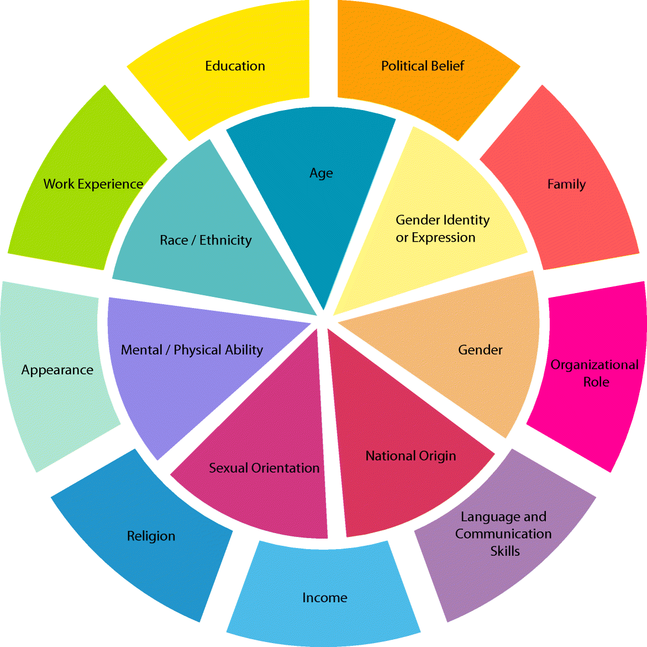
Collective Opportunity
Where can we extend/activate our power
Education & intentionality
Notes:
Coined Dr, ‎Kimberlé CrenshawIntersectionality is the acknowledgement that everyone has their own unique experiences of discrimination and oppression and we must consider everything and anything that can marginalise people – gender, race, class, sexual orientation, physical ability, etc.

Slide 13
Our Makeup
Advantages Disadvantage

Slide 14
Cultivating Support
“Hey, I just wanted to check in? How are you feeling?
“Do you have a particular holiday or celebration that’s meaningful to you in & your culture”
“What do you do to unwind on the weekend?”
"Are there causes that hold significant importance in your life?"
"Are there parts of your identity/background you'd like to express more at work?"
"Are there assumptions made about your identity that are particularly bothersome to you?"
Notes:
Simply asking to check in assumes little and gives space to share as comfortable
Seek alternative ways to understand relationships that matter to them

Slide 15
Discussion

Slide 16
Thank you

